Slide 1
LOUISA BOREN K-8 STEM PTA
2022-2023 Budget (1st PTA Meeting)

Slide 2
STEM K-8 PTA Mission/Values
Enhance STEM learning
Support PBL as a core tenet of our curriculum
Enrichment
School/Teacher/Staff Support
Help create a safe space
Student/Family/Community Building

Slide 3
What the PTA Funds
STEM Curriculum Support
Classroom Funds for Teachers
Teacher Professional Development
Project Based Learning Classroom Support
Career & Tech Ed Support
Field Trip Scholarships and Support (e.g., 4th/5th/8th grade trip support)
Robotics Club
Kiln Support
Salmon Tank
School/Teachers/Staff
School Grounds (e.g., campus improvements, garden, playground equipment)
Library Support
Staff Appreciation
Safety Patrol/Initiatives
Students/Family/Community
Assemblies
Field Days
Graduation
Family Engagement and Education
Events (e.g., B2SB, PBL Nights)
GGLOW Activities
Race/Equity Activity
COVID Family Support
Enrichment Classes/Coordinator/Scholarships
PTA Operations (e.g., Banking Fees, Financial Software, Insurance, Copying, Postage, Supplies)

Slide 4
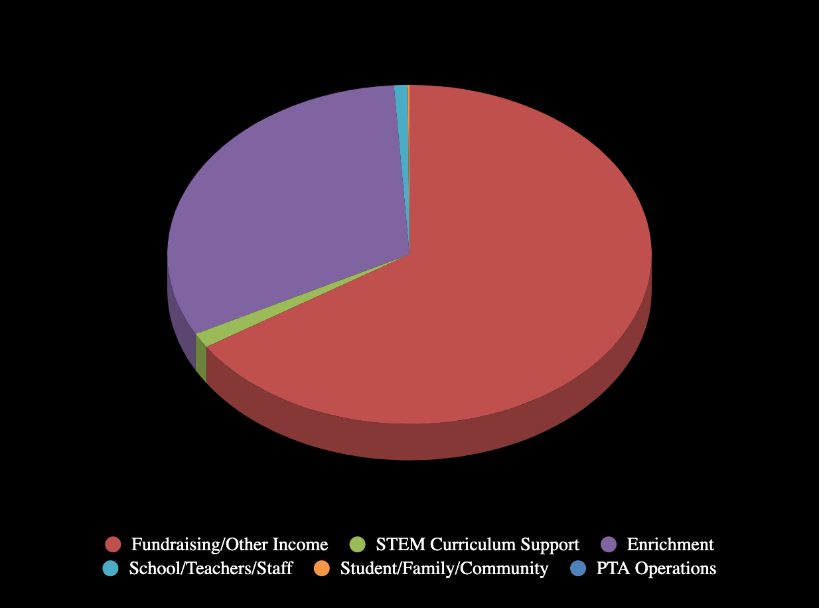
Projected Income July 1, 2022 – June 30, 2023

Slide 5
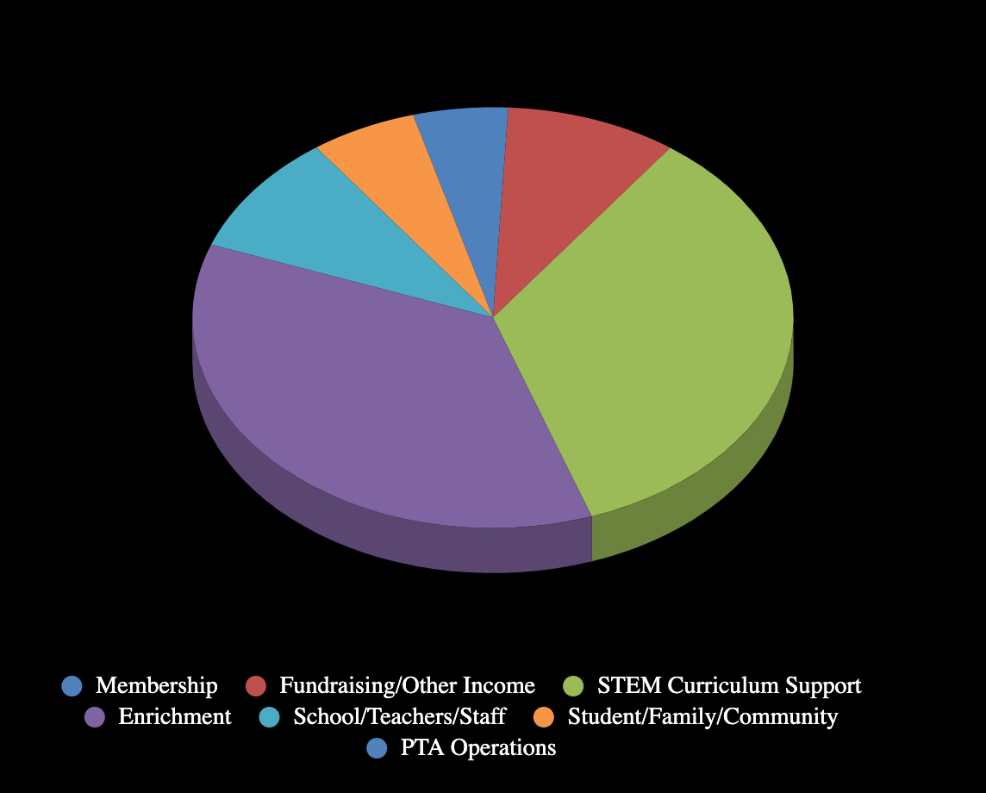
Projected Expenses July 1, 2022 – June 30, 2023

